Slide 1
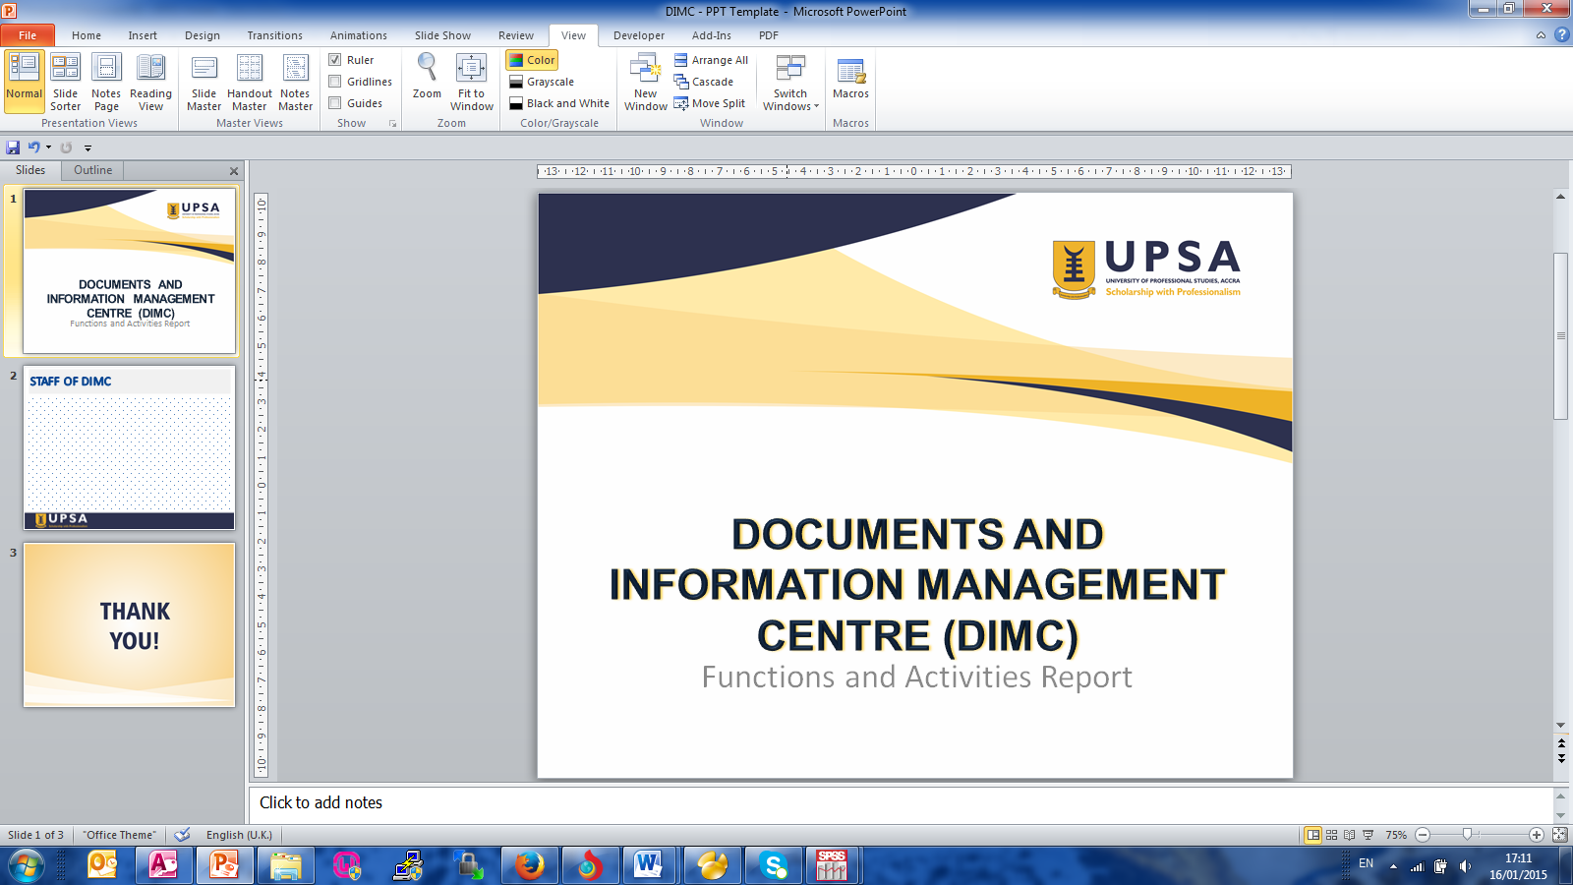
COMPUTER AND NETWORK SECURITY LECTURE 3 CRYPTOGRAPHY
BY DR. SELASI OCANSEY

Slide 2

CONTENTS
Intro. to Cryptography
Encryption/Decryption
Symmetric/Asymmetric Algorithms

Slide 3
CRYPTOGRAPHY
Cryptography is the science of using mathematics to encrypt and decrypt data.
Cryptography enables you to store sensitive information or transmit it across insecure networks (like the Internet) so that it cannot be read by anyone except the intended recipient.
A big part of cryptography involves finding out ways that we can keep our messages secret from adversaries that may be eavesdropping on us.

Slide 4
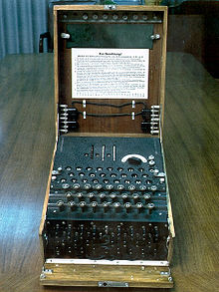
WAR TIME USE OF CRYPTOGRAPHY

Slide 5
WHAT CAN CRYPTOGRAPY DO?
Crypto can provide the following security services:
Confidentiality: Makes data unreadable to entities who do not have the appropriate cryptographic keys, even if they have the data.
Data Integrity: Entities with the appropriate cryptographic keys can verify that data is correct and has not been altered, either deliberately or accidentally.
Authentication: Entities who communicate can be assured that the other user/entity or the sender of a message is what it claims to be.

Slide 6
WHAT CAN CRYPTOGRAPY DO?
Digital Signature and PKI (Public-Key Infrastructure):
Strong proof of data origin which can be verified by 3rd parties.
Scalable (to the whole Internet) distribution of cryptographic keys.
Non-Repudiation:
non-repudiation removes the sender’s ability to deny that they were responsible for sending something.

Slide 7
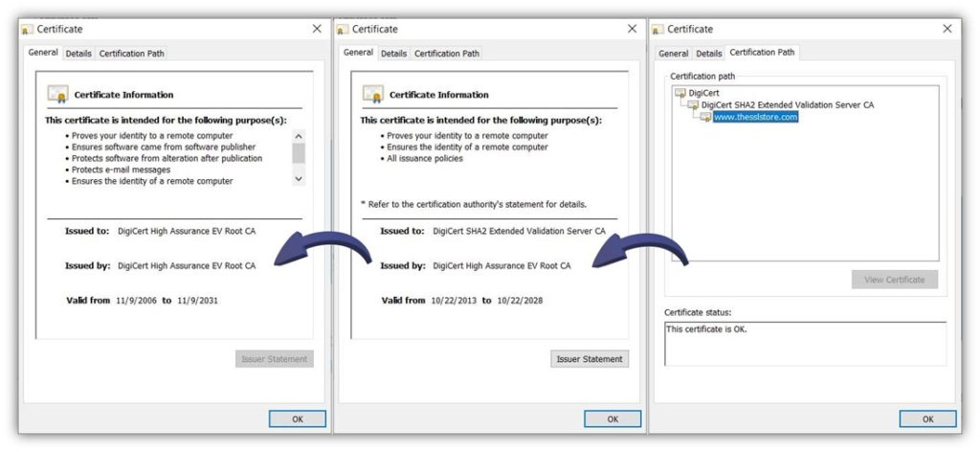

Slide 8
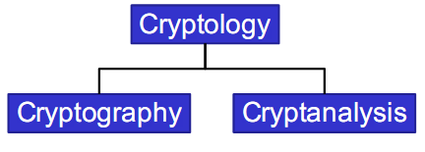
TERMINOLOGIES
Cryptography is the science of secret writing with the goal of hiding the meaning of a message.
Cryptanalysis is the science of breaking cryptography.
Cryptology covers both cryptography and cryptanalysis.

Slide 9
CRYPTOGRAPHY
Cryptography is the science of secret, or hidden writing
It has two main Components:
Encryption
Practice of hiding messages so that they can not be read by anyone other than the intended recipient
Authentication & Integrity
Ensuring that users of data/resources are the persons they claim to be and that a message has not been surreptitiously altered

Slide 10
WHY IS CRYPTOGRAPHY IMPORTANT?
Cryptography is arguably the best method available today for protecting security-sensitive data.
The unique “code/key/calculations” combination required to encrypt and decrypt data makes the technique an efficient method for keeping information protected from prying eyes.
The heavy usage of the internet for business and personal communications makes encryption a must for any sensitive data.
Without cryptography, any message you send on the internet could be intercepted and read. Everything from a private message to your spouse to the information about your bank account would be open to public examination.
Protect your backups against unauthorized access.

Slide 11
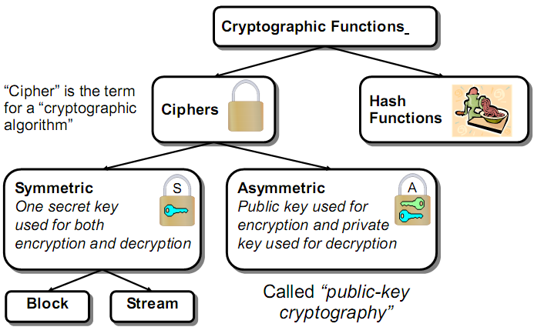
TAXONOMY OF CRYPTOGRAPHY

Slide 12
Encryption as a counter measure
Threat: An attacker who controls the communication network. This attacker can arbitrarily read, modify, and delete messages. Think of this communication model as one in which messages are always sent to the attacker, never to the intended recipient. The attacker can then forward the message along if he chooses, redirect the message, save it for later replay, etc. This kind of threat is called a Dolev–Yao attacker.
Harm: Messages containing secret information could be disclosed to the adversary, thus violating confidentiality.
Vulnerability: The communication channel between sender and receiver can be read by untrusted principals.
Countermeasure: Encryption.
Notes:
1. Must have done this as an assignment last year.

Slide 13
Encryption Cipher
Cipher is a method for encrypting and decrypting of messages
Encryption algorithms are standardized & published
The key which is an input to the algorithm is secret
Key is a string of numbers or characters
If same key is used for encryption & decryption the algorithm is called symmetric
If different keys are used for encryption & decryption the algorithm is called asymmetric
Plain Text
Encryption
Algorithm
Cipher Text
Decryption
Algorithm
Plain Text
Key A
Key B
Notes:
1. Must have done this as an assignment last year.

Slide 14
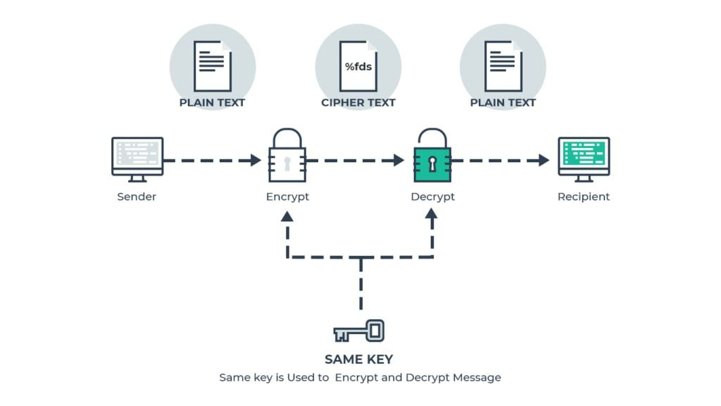
Encryption
Notes:
1. Must have done this as an assignment last year.

Slide 15
TERMINOLOGY
Encryption: plaintext (cleartext) P is converted into a ciphertext C under the control of a key k.
– We write C = E(P, k).
Decryption with key k recovers the plaintext P from the ciphertext C.
– We write P = D(C, k).
Symmetric ciphers: the secret key is used for both encryption and decryption.

Slide 16
TERMINOLOGY
Asymmetric ciphers: Pair of private and public keys where it is computationally infeasible to derive the private decryption key from the corresponding public encryption key.
Hashing: Hashing is a function designed to take a message string of any length and produce a fixed-length hash value.

Slide 17
MESSAGE INTERGRITY
Encryption ensures message privacy, preventing unauthorized people from viewing the content of a message.
It does not, however, ensure message integrity, preventing someone from changing the message while it is in transit.
One widely used solution is to create a message digest, or digital signature, a compressed transformation of the message that has the property that a small change in the input (the message) produces a large change in the output (the message digest).
The message digest is computed as the message is assembled for transmission and attached to the message itself. The recipient then recomputes the message digest and compares it to what was received. If the two digests don’t match, then the message was altered during transmission.

Slide 18

MESSAGE INTERGRITY
Reality Check
Even if the sent and received message digests don’t match, it doesn’t necessarily mean that someone tampered with the message.
It could very well be that the message was damaged in transmit and some bits were altered.
The message digest, therefore, serves as an error checking mechanism as well as ensuring message integrity

Slide 19
HASHING
Hashing is a function designed to take a message string of any length and produce a fixed-length hash value. The reason to use hashing is not to hide the information included in the string but to instead verify the string’s contents.
Hashing is most commonly used to protect the transmission of and verify software downloads. A vendor will calculate a hash for a downloadable file and publish the hashed checksum string.
When a user downloads the file, they can run it through the same hashing algorithm (SHA). If the hashed checksum strings match, then the download is complete and the file is authentic.

Slide 20
HASHING
If there is a variation between the two checksums, it indicates that either the download did not complete properly, or it was intentionally modified by an outside party.
Hashing is a particularly good way to verify downloads of operating system software, as well as the Windows .ISO files, or Mac .DMG files used to install apps.
A demonstration of how it works is shown in the screenshot below. If a user wanted to verify that the movie quote below was the exact one sent by their movie-loving friend, they would run the quote through the SHA-256 Hash Calculator to verify it.

Slide 21
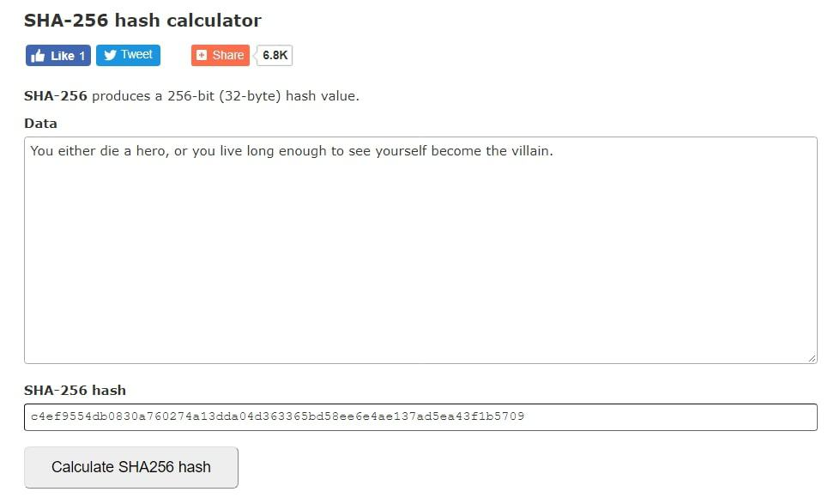
HASHING

Slide 22
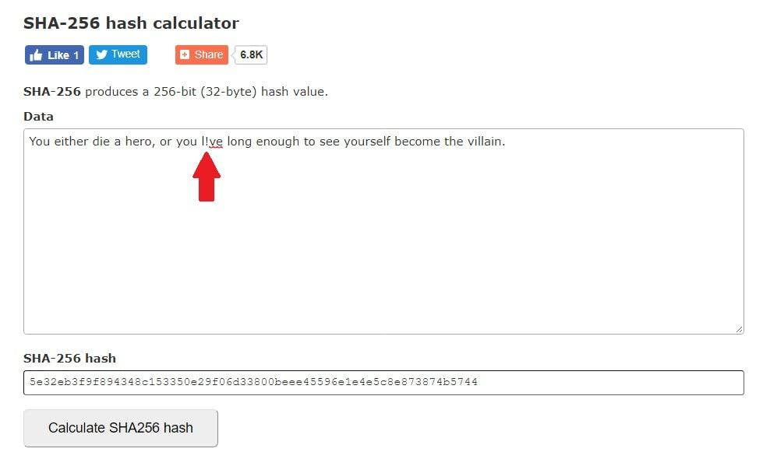
HASHING
If the message has been modified during transmission – even by only one character! – it will show a vastly different hash, as seen below, indicating that the message has been changed.

Slide 23
HASHING
Advantages
Hashing is a great way to ensure the integrity of a message or a downloaded file.
If the hashed value for a file matches on both ends of a transmission, the user can feel secure that the file has been completely downloaded and has not been tampered with.
Disadvantages
Hashing doesn’t actually encrypt a file. This is better left to the types of cryptography

Slide 24
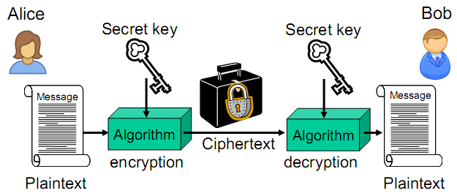
SYMMETRIC CRYPTOGRAPHY (SECRET KEY)
“Secret key” means that the key is shared “in secret” between entities who are authorized to encrypt and decrypt

Slide 25
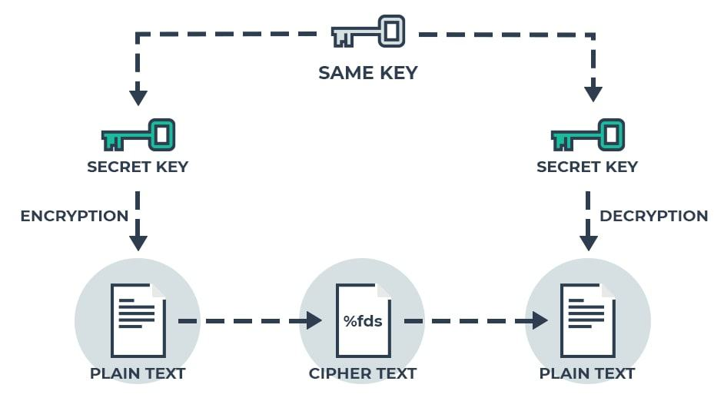
SYMMETRIC CRYPTOGRAPHY (SECRET KEY)

Slide 26
SYMMETRIC ENCRYPTION
Symmetric cryptography is one of the simplest types of encryption, as it involves the use of only one secret key to both encrypt and decrypt data.
This is one of the oldest and best-known methods of encryption available today.
Symmetric cryptography uses a secret key, which can be a number, word, or string of random letters.
The key must be known to both the sender and the recipient in order to complete the process.
Notes:
1. Must have done this as an assignment last year.

Slide 27
SYMMETRIC ENCRYPTION
Advantages
This method of cryptography is easy to use due to the simplicity of all parties using a single key.
There is also a slight advantage in speed, as a single key is used for encryption/decryption, reducing the mathematical complexity of the process.
Disadvantages
Symmetric cryptography isn’t generally used for sending messages over the internet, as the key needs to be sent separately. If a third party were to somehow obtain the key, they would be able to view the encrypted data.
Notes:
1. Must have done this as an assignment last year.

Slide 28
ASYMMETRIC ENCRYPTION
Asymmetric cryptography uses two separate keys: one for encryption and the other for decryption. Asymmetric cryptography uses both a private and a public key.
The public key is used to encrypt the message or other data, while the private key is used to decrypt the information. A message encrypted using a public key can only be decrypted by using the private key.
The public key can be made freely available to anyone who wants to send you a message, while the private key is a secret that only you know. While this is a bit more complicated, it provides an added level of security over symmetric encryption.
Just a few popular uses of asymmetric encryption include sending emails and attachments, connecting to remote servers, and accessing secure websites.(The URL for a secure website begins with “https://”)

Slide 29
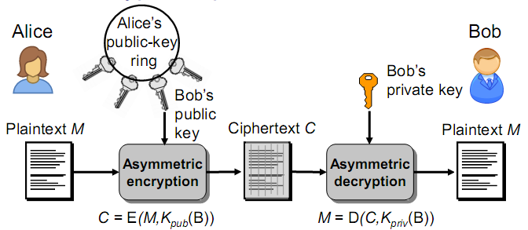
ASYMMETRIC ENCRYPTION: BASIC ENCRYPTION OPERATION
In practical applications, large messages are not encrypted directly with asymmetric algorithms. Hybrid systems are used.
Example: Advanced encryption standard (AES) and by Ron Rivest, Adi Shamir, Len Adelman (RSA)

Slide 30
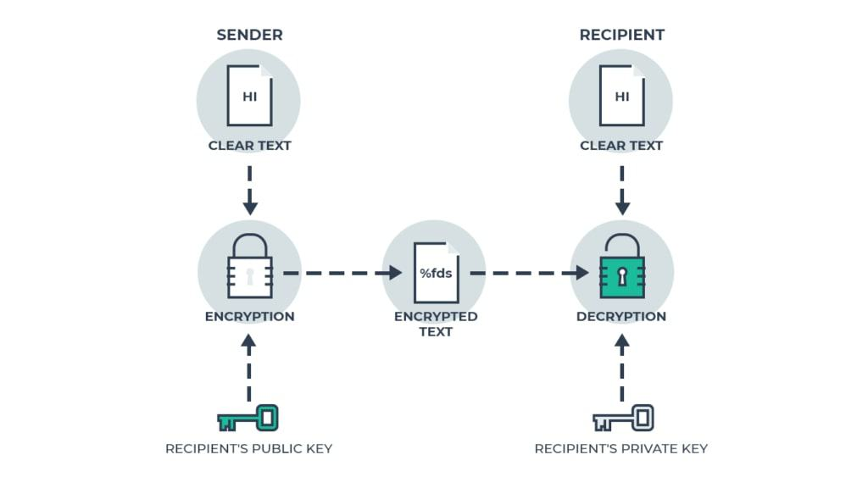
ASYMMETRIC ENCRYPTION: BASIC ENCRYPTION OPERATION

Slide 31
ASYMMETRIC ENCRYPTION
Advantages
Asymmetric cryptography is more secure than symmetric cryptography due to its use of public and private keys for the cryptography process.
It eliminates the need to share a single key, making it more secure than symmetric cryptography.
Disadvantages
Asymmetric cryptography is a more mathematically complex form of cryptography than symmetric, with more overhead, meaning the encryption and decryption processes take longer, slowing data transmission by a bit.

Slide 32
ASYMMETRIC ENCRYPTION
Disadvantages
This is why, when you use a VPN to protect your internet connection, the asymmetrically encrypted connection speed is slower than your normal, ISP-only speeds.
Also, if you were to lose your private key, it would be impossible to decrypt any ciphertext you might receive, leaving the information permanently unreadable.

Slide 33
KEYS
In cryptography, we secure a message by encrypting the message with a certain key and then sending it over the network.
The security of the encryption usually depends on the key length or size.
Key length (a.k.a. key size) is the number of bits of a key used to encrypt a message.
Key size is measured in bits; In public-key cryptography, the bigger or longer the key, the more secure the ciphertext.
Larger keys will be cryptographically secure for a longer period of time. Keys are stored in encrypted form.

Slide 34
KEY EXCHANGE ALGORITHM
Cryptography using key exchange algorithms isn’t used much by individuals outside of the cyber-security industry.
Key exchange algorithms allow for the safe exchange of encryption keys with an unknown party.
Users don’t share information during the key exchange. The end goal is to create a custom encryption key that can be used by both parties at a later date.
Perhaps the best-known key exchange algorithm is Diffie-Hellman.
Diffie-Hellman establishes a shared secret between two users that can then be used to exchange secret information over a public network.

Slide 35
KEY EXCHANGE ALGORITHM
Advantages
In real-life applications, key exchange algorithms would use large numbers raised to specific powers to create keys. This alone makes the process of breaking the code mathematically overwhelming.
Disadvantages
Communications using these algorithms are vulnerable to “Man-in-the-Middle” attacks. Ideally, this method should be used in conjunction with other authentication methods, such as a digital signature.

Slide 36
PGP (Pretty Good Privacy encryption)
PGP encryption or Pretty Good Privacy encryption, is a data encryption computer program that gives cryptographic privacy and authentication for online communication.
It is often used to encrypt and decrypt texts, emails, and files to increase the security of emails. PGP encryption uses a mix of data compression, hashing, and public-key cryptography.
It also uses symmetric and asymmetric keys to encrypt data that is transferred across networks. It combines features of private and public key cryptography.

Slide 37
PGP (Pretty Good Privacy encryption)
When plaintext is encrypted with PGP, it first compresses the plaintext. Data compression saves transmission time, disk space, and reinforces cryptographic security.
The asymmetry of PGP encryption allows for authentication. After public keys have been traded among partners, the private keys are used to digitally sign the encrypted content. This allows the decryptor to confirm the sender.
Another aspect of PGP is message authentication and integrity checking. Integrity checking is used to detect if a message has been altered after it was written and to determine if it was actually sent by the claimed sender.

Slide 38
ASSIGNMENT
Study and analyze the following;
Examples of cryptographic methods that use symmetric key
Examples of cryptographic methods that use assymmetric key
Notes:
1. Must have done this as an assignment last year.

Slide 39
How Is Cryptography Used in Security?
There are 4 main ways that cryptography is used to ensure data security. These are called “cryptographic functions.”
Authentication
Non-Repudiation
Confidentiality
Integrity

Slide 40
How Is Cryptography Used in Security?
Authentication: Authentication, simply put, is a process put in place to ensure that the parties on both ends of the connection are actually who they claim to be.
You encounter at least one type of authentication used on the web whenever you use a secure website, such as your company’s intranet site or even Amazon.
Secure websites use what is called an SSL certificate, which provides proof that the owner of the website owns a public cryptography key and shows that a user is connected to the correct server.

Slide 41

How Is Cryptography Used in Security?
Depending on the browser they use, an online user will see a closed padlock or a green URL (or both) to indicate that the website they are connected to is the one it claims to be.
This is particularly valuable when shopping online, or doing your banking or bill-paying online. This helps ensure that you’re not handing your banking or credit card info over to a hacker.

Slide 42
How Is Cryptography Used in Security?
Another example of cryptography being used for authentication purposes is Pretty Good Privacy, which is a freeware software package that is used to provide encryption and authentication for messaging, digital signatures, and data compression, as well as emails and their attachments.

Slide 43
How Is Cryptography Used in Security?
Non-repudiation: In the early days of online financial and e-commerce dealings, some users would approve an online transaction, then later claim they had never approved the transaction.
Cryptographic non-repudiation tools were created to ensure that a specific user had indeed made a transaction, which could not be disclaimed later on for the purposes of a refund.
This prevents online banking users from authorizing a funds transfer to an outside account, then coming back a few days later claiming they had not made the transaction and demanding the money be refunded to their account.

Slide 44
How Is Cryptography Used in Security?
A bank can prevent the above attempt to steal funds by putting the correct non-repudiation measures in place, which can consist of hashed data, digital certificates, and more.

Slide 45
How Is Cryptography Used in Security?
Confidentiality: Confidentiality, or keeping your private data private, is one of the most important security applications for any user.
Today’s constant data breaches, which are usually due to a lack of proper cryptography for the task at hand, make the appropriate use of cryptography a must for any secure process.
Integrity: Cryptography can ensure that no one can change or view data while it’s in transit or in storage.
Cryptography can ensure that a rival company, or any other party hoping to profit from data tampering, cannot screw around with a company’s sensitive data and internal correspondence.

Slide 46
Is Cryptography Foolproof? Can It Be Cracked?
Although cryptography increases your security level, nothing can provide a total level of security, as attacks on the Broward Health, Ashley Madison, and Target department stores should prove.
It should be noted that many of the “hacks” in cases like these were successful due to a lack of proper cryptography usage on the target’s end of things.
Don’t lay awake at night wondering if a hacker is working at that moment to steal money you have in your savings account. But also don’t simply give up, not taking the proper precautions to protect your information. You should continue to use encryption whenever it is available.

Slide 47
DAILY USAGE OF CRYPTOGRAPHY
Virtual Private Networks (VPNs): A Virtual Private Network (VPN), such as NordVPN, encrypts your internet connection, preventing any outsiders from monitoring your online activities or stealing any of your valuable personal or business-related information.
HTTPS: HTTPS (the “S” stands for “secure”) offers a layer of encryption, protecting any data you receive or send to the website from outside monitoring.
Encrypt Your Computer or Mobile Device

Slide 48
HYBRID CRYPTOSYSTEMS
Symmetric ciphers are faster than asymmetric ciphers (because they are less computationally expensive ), but ...
Asymmetric ciphers simplify key distribution, therefore ...
a combination of both symmetric and asymmetric ciphers can be used – a hybrid system:
– The asymmetric cipher is used to distribute a randomly chosen symmetric key.
– The symmetric cipher is used for encrypting bulk data

Slide 49
CIPHER OPERATIONS
There are basically two types of symmetric cipher
Substitution Cipher
Transposition Cipher
Substitution Cipher: Each element of the plaintext (bit, letter, group of bits) is mapped to another element
Transposition Cipher: In transposition technique, there is not replacement of alphabets or numbers occurs instead their positions are changed or reordering of position of plaintext is done to produce ciphertext

Slide 50
Substitution Ciphers Caesar Cipher
Caesar Cipher is a method in which each letter in the alphabet is rotated by three letters as shown
A B C D E F G H I J K L M N O P Q R S T U V W X Y Z
D E F G H I J K L M N O P Q R S T U V W X Y Z A B C
Let us try to encrypt the message
Attack at Dawn
Assignment: Each student will exchange a secret message with his/her closest neighbor about some other person in the class and the neighbor will decipher it.

Slide 51
Substitution Ciphers Caesar Cipher
Encryption
Plain Text
Message:
Attack at Dawn
Cipher:
Caesar Cipher
Algorithm
Cipher Text
Message:
Dwwdfn Dw Gdzq
Key (3)
Cipher Text
Message:
Dwwdfn Dw Gdzq
Cipher:
Caesar Cipher
Algorithm
Plain Text
Message:
Attack at Dawn
Key (3)

Slide 52
Substitution Cipher -Monoalphabetic Cipher
Any letter can be substituted for any other letter
Each letter has to have a unique substitute
There are 26! pairing of letters (~10²⁶)
Brute Force approach would be too time consuming
Statistical Analysis would make it feasible to crack the key
A B C D E F G H I J K L M N O P Q R S T U V W X Y Z
M N B V C X Z A S D F G H J K L P O I U Y T R E W Q
Message:
Bob, I love you.
Alice
Cipher:
Monoalphabetic
Cipher
Encrypted
Message:
Nkn, s gktc wky.
mgsbc
Key

Slide 53
POLYALPHABETIC CIPHER (VIGENERE CIPHER)
Vigenere Cipher is a method of encrypting alphabetic text. It uses a simple form of polyalphabetic substitution.
A polyalphabetic cipher is any cipher based on substitution, using multiple substitution alphabets
The encryption of the original text is done using the Vigenere Square or Table
The table consists of the alphabets written out 26 times in different rows, each alphabet shifted cyclically to the left compared to the previous alphabet

Slide 54
POLYALPABETIC CIPHER (VIGENERE CIPHER)
Create vigenere table as per your given keyword (If vigenere table is not given)
Given keyword arrange in alphabetical order then create table as per given below. (Example Keyword= MEC)
Plaintext
 | A | B | C | D | E | F | G | H | I | J | K | L | M | N | O | P | Q | R | S | T | U | V | W | X | Y | Z
C | C | D | E | F | G | H | I | J | K | L | M | N | O | P | Q | R | S | T | U | V | W | X | Y | Z | A | B
E | E | F | G | H | I | J | K | L | M | N | O | P | Q | R | S | T | U | V | W | X | Y | Z | A | B | C | D
M | M | N | O | P | Q | R | S | T | U | V | W | X | Y | Z | A | B | C | D | E | F | G | H | I | J | K | L
Keyword

Slide 55
POLYALPHABETIC CIPHER (VIGENERE CIPHER)
Plaintext: I AM A GHANAIAN Keyword: MEC
Key | M | E | C | M | E | C | M | E | C | M | E | C
PlainText | I | A | M | A | G | H | A | N | A | I | A | N
CipherText | u | e | 0 | m | k | j | m | r | c | u | e | p
Key | M | E | C | M | E | C | M | E | C | M | E | C
CipherText | u | e | 0 | m | k | j | m | r | c | u | e | p
PlainText

